Slide 1
CSE 431
Task 2 - Paper Review
Paper : Transfer Learning, Style Control, and Speaker Reconstruction Loss for Zero-Shot Multilingual Multi-Speaker Text-to-Speech on Low-Resource Languages
Paper Link : https://ieeexplore.ieee.org/abstract/document/9673749
Members:
Fahmida Ahmed – 22241167
Md. Muhtadee Faiaz Khan Soumik - 19101491
Syed Ziaul Bin Bashar - 19101166
1

Slide 2
Systems built on deep neural networks (DNNs) typically need a lot of training data, which makes them problematic for languages with limited resources. Recent studies have been successful in developing zero-shot multi-speaker DNN-based TTS on languages with a high resource requirement, but their performance on unseen speakers is still subpar.
For overcoming the problem of data scarcity in the DNN-based (Text -to-Speech) TTS on low-resource languages and improving the performance of zero-shot speaker adaptation for unseen speakers.
Zero-shot methods generally work by associating observed and unobserved classes through some form of auxiliary information, which encodes observable distinguishing properties of objects.
In this paper, Zero Shot Multilingual Multi-Speaker Text-to-Speech has proposed on Low-Resource Languages and training strategy has succeeded in increasing the speaker cosine similarity of the synthesized speech on the unseen
speakers test set by 0.468 and 0.279 in native and foreign languages respectively by focusing on how to improve style encoder network and utterance level speaker reconstruction loss.
2

Slide 3
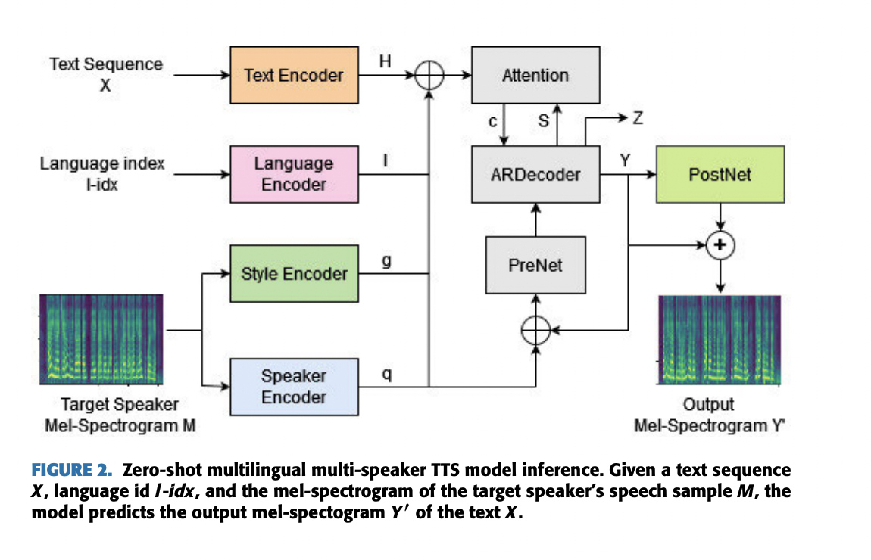
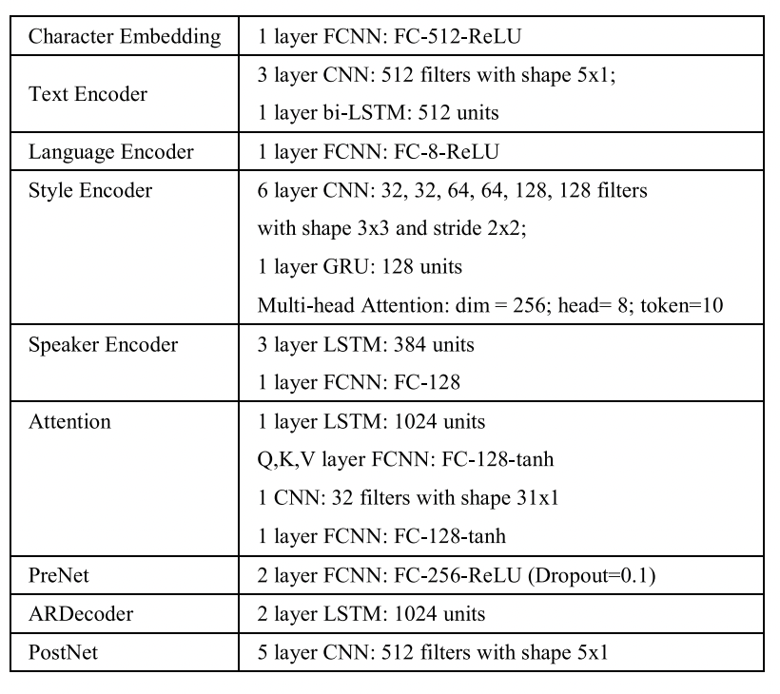
METHODS
A. PARTIAL NETWORK-BASED DTL
This approach is based on the principle that transferring weight parameters, even if only partially, is more effective than training them from scratch. Partial transfer allows to fine-tune the higher dimensional weight vector/matrix/tensor of the target model by making use of the low dimensional weight vector/matrix/tensor learned from the source model
B. ZERO-SHOT TTS MODEL ARCHITECTURE
Here the model is based on an end-to-end TTS attention-based encoder decoder that can predict melspectrogram y’ = (y’₁ , . , y’_{TY} ) directly from the input grapheme-level text sequences x = (x₁, . . . , x_{Tx} ), language identity LangID, and the mel-spectrogram of the target speaker speech sample M = (m₁ , . . . , m_{TM} ). The predicted mel-spectrogram is then converted into a speech waveform using WaveGlow vocode.
The Zero-shot TTs has 4 type of encoders - Text Encoder, Language Encoder, Style Encoder Speaker Encoder. Mel-Spectrogram is used for decoding.
4
Notes:
This approach is based on the principle that transferring weight parameters, even if only partially, is more effective than training them from scratch. Partial transfer allows us to fine-tune the higher dimensional weight vector/matrix/tensor of the target model by making use of the low dimensional weight vector/matrix/tensor learned from the source model
The model is based on end to end TTS based encoder decoder which can predict emlspectrogram directly from input text sequence. The predicted model later converts it into a speech waveform.

Slide 4
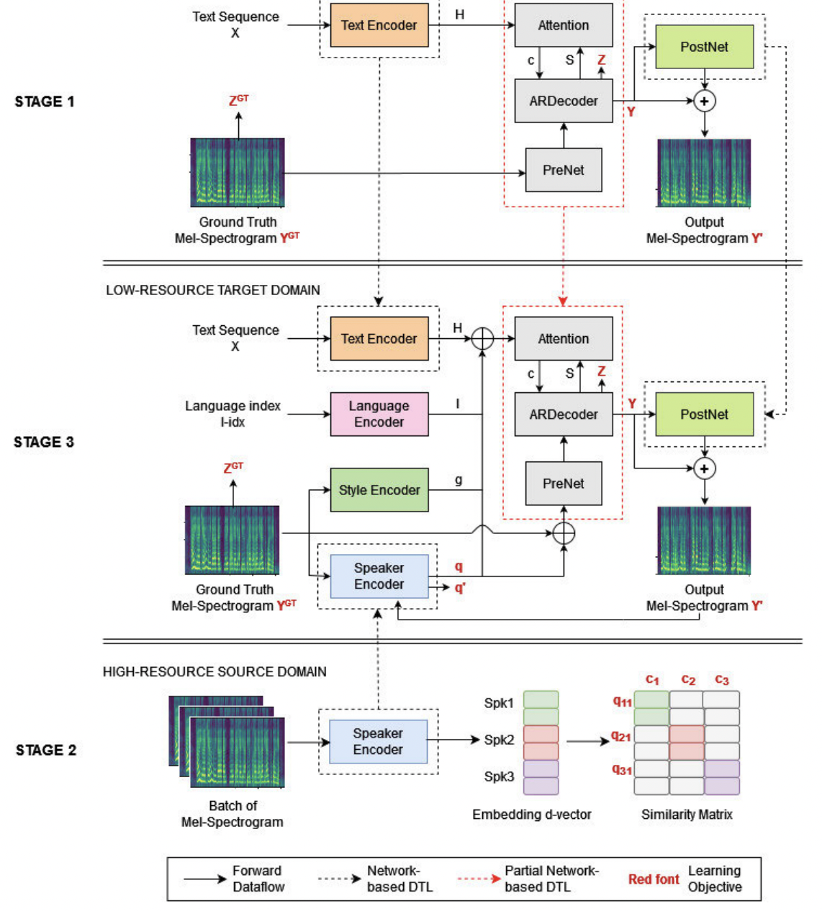
C. TTS MODEL TRAINING
Zero-shot multilingual multi-speaker TTS model training.
It consists of three training stages that include transfer learning. Stage 1 (Top) trains the monolingual single-speaker TTS on a high-resource language as the first source model. Stage 2 (Bottom) trains the speaker encoder on a high-resource language as the second source model. In Stage 3 (Middle), it transfers the trained sub-networks from the source models to the target model. The black dashed box indicates full network-based DTL, while the red dashed box indicates a partial network-based DTL. The target model is then trained on the low-resource languages as the target domain.
5
Notes:
Stage 1 : trains the monolingual single speaker TTS on a high resource language as the first source
Stage 2 : trains speaker encoder on a high resource language as second source
Stage 3 : Transfers the trained sub-networks from the souce to the target model.
Finally the target model is then trained on the low resource language as the target domain

Slide 5
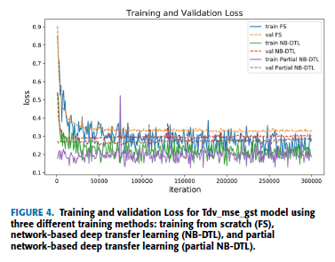
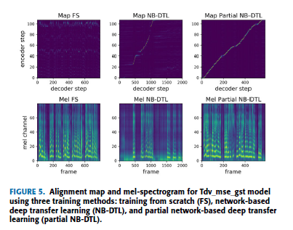
The graph of training and validation loss shows that the more the parameters are transferred from the pre-trained source model to the target model, the lower (better) the loss value and the faster the model achieves convergence. It shows the learning process comparison of the zero shot multilingual multi-speaker TTS using the three training schemes. NB-DTL scheme is better than FS scheme, but it still has not succeeded in producing a reasonable alignment map. Both schemes are unable to produce an intelligible synthesized speech. Meanwhile, the proposed partial NB-DTL scheme successfully generates a diagonal alignment map and is able to synthesize intelligible speech sound.
All models are trained using partial network-based DTL. In addition to dividing the test categories into seen and unseen speaker test,
we also divide them into native and foreign language test. Native language test refers to target speakers of a language used to synthesize text in the same language, while foreign language test refers to target speakers of a language used to synthesize text in different languages.
6

Slide 6
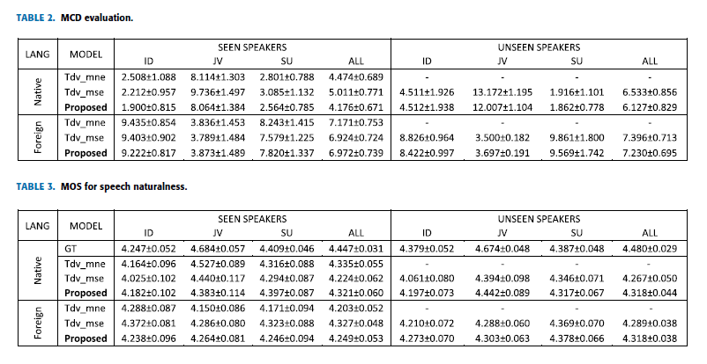
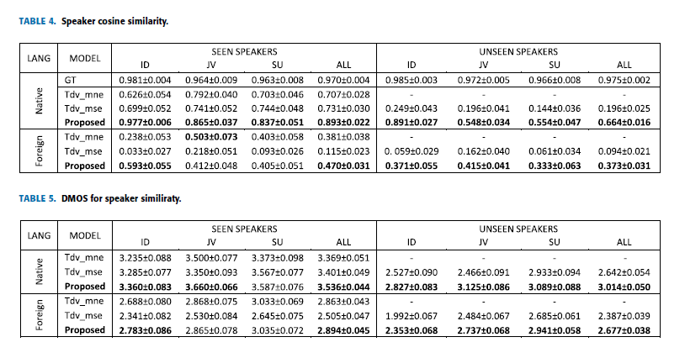
The MCD evaluation shows that there is no significant difference between baseline models and our proposed model, between seen and unseen speakers, as well as between native and foreign languages. For the MOS test, respondents were asked to listen to a set of speech utterances generated by the baseline models, the proposed model, and the original human voice. To measure the speaker similarity of the synthesized speech sound and the target speaker's speech sound, the utterance-level d-vector speaker representation of the synthesized sound to the d-vector speaker model of the same target speaker using cosine similarity. For the DMOS test, the proposed model received the highest speaker similarity rating from respondents on both seen and unseen speaker test as well as on both native and foreign languages test.
The experiments show that our proposed model and loss function significantly improve the performance of zero-shot speaker
adaptation for both seen and unseen speakers in both native and foreign languages. For future work apart from leveraging
transfer learning the future model can combine machine learning with linguistic knowledge such as a phonetic dictionary, combined with the latest TTS technology for further development of more than 700 low-resource ethnic languages. The use of a dataset containing multilingual speakers where a speaker speaks several languages can also be explored further to improve zero-shot speaker adaptation in foreign languages.
6

